Slide 1
Unit 6: ICT applications
6.13 Computers in the retail industry
Page 123 - 124

Slide 2
• Describe the use of point of sale (POS) terminals, how the stock file is updated automatically, and how new stock can be ordered automatically
• Describe the use of electronic funds transfer at point of sale (EFTPOS) terminals (e.g. the checking of the validity of cards, the use of chip and PIN, the communication between the supermarket computer and the bank computer)
• Describe internet shopping
• Discuss the advantages and disadvantages of internet shopping

Slide 3
Technology in retail
• Describe what types of technology are used in the retail industry

Slide 4
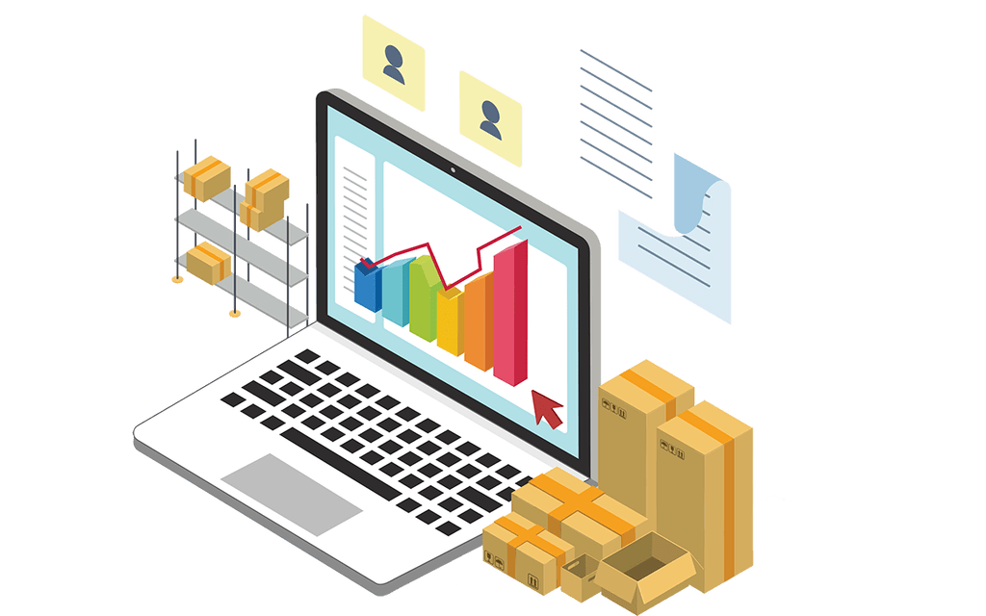
Technology in retail
What is Stock Control?
Every business needs to keep track of the items that it manufactures or sells (the stock). The system that monitors the items in stock is called the stock control system. E.g. in a store, the stock includes all of the items on the shelves and out the back in the storeroom. It is important that a business does not keep too much stock, nor too little. Too much stock costs money as you have to store it all somewhere
Too much perishable stock (e.g. food) means that it may go bad before it is sold
Too little stock means that you might run out of stock before the next delivery arrives

Slide 5
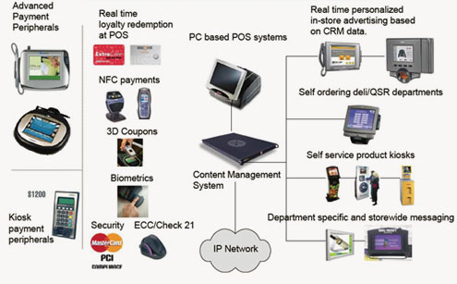
Retail industry
Describe the use of point of sale (POS) terminals, how the stock file is updated automatically, and how new stock can be ordered automatically

Slide 6
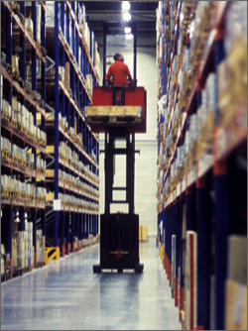
Retail industry
Describe in your own words the use of point of sale (POS) terminals, how the stock file is updated automatically, and how new stock can be ordered automatically
Step 1: Each product has a different barcode and when you buy the products they will be scanned at the EPOS with a barcode scanner. The barcode is searched for on the stock file and the quantity of the product is updated and reduced by one every time it’s scanned. If the quantity reaches the predetermined programed number for re-ordering, the computer will automatically order a programed amount of products. Once ordered, the products will be flagged to the stock file as ‘ordered products’ so the system wouldn’t order the products again. When the products arrive, flags that indicate that they’re ’ordered products’ will be removed and the stock file can update the quantity of the product.

Slide 7
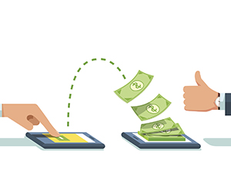
Retail industry
Describe the use of electronic funds transfer at point of sale (EFTPOS) terminals (e.g. the checking of the validity of cards, the use of chip and PIN, the communication between the supermarket computer and the bank computer)
EFT is a system that allows money transfer commands to be sent right away to a bank’s computer system. Physical money is not transferred. When a money transfer command is sent, the computer system directly transfers the certain amount from one account to another.
If you pay by credit cards then they will have a chip that contains a PIN and you pay by entering in the PIN using a keypad, the card is then verified for its validity, if the card is still valid and you entered the correct PIN then your payment is successful.

Slide 8
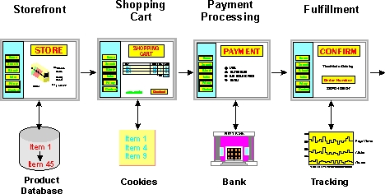
Internet Shopping
• Describe internet shopping

Slide 9
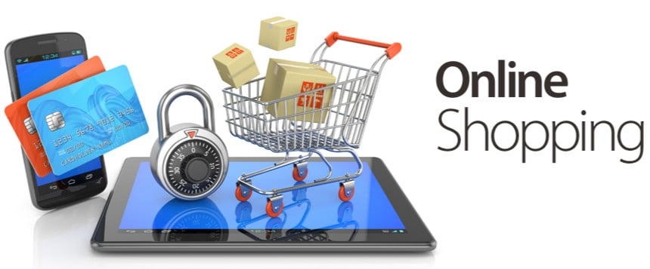
Internet Shopping
Discuss the advantages and disadvantages of internet shopping
Advantages:
1. No need for travel
2. Time saving
3. Are able to access to a worldwide market and find better deals than the ones at stores
4.Highly beneficial for people who have troubles moving around (disability)
5. Shopping can be done literally anytime
Disadvantages:
1.Lacks socializing therefore isolation increases
2. Health risks because people don’t move around
3. Security problems (hacking, stealing, fraud etc)
4.Requires a technological device
5. Unable to view products directly, unable to try on products

Slide 10
Extension
Find out as many areas in the retail industry that use barcodes (including QR codes) and explain why barcodes are used. What other methods exist which could replace barcodes? Why have these other methods not been adopted?
“IN”

