Slide 1
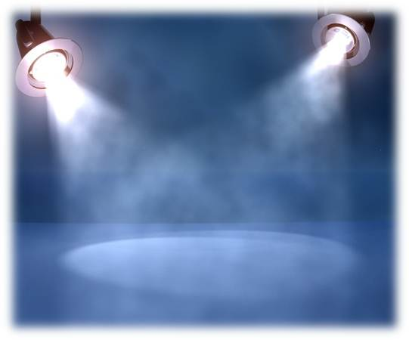
By Laura, Thao Nhi, Thien, Bo and Trang Anh
THE ANCIENT ROMAN
CIVILIZATION

Slide 2
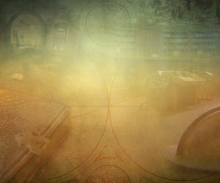
Timeline of important events
753 BC Rome is founded
509 BC Rome becomes a Republic
45 BC Julius Caesar becomes the first dictator of Rome
Julius Caesar defeats Pompey in a civil war. He becomes the supreme ruler of Rome. This is the end of the Roman Republic. He was assassinated in 44BC.
27 BC Roman Empire begins
64 Much of Rome burns
380 Christianity
Rome becomes a Christian empire. Before this, Rome persecuted the Christians.
Theodosius I proclaims Christianity as the sole religion of the Roman Empire .
395 Rome splits
In 395 AD, Rome split into two empires - the Western Roman Empire and the Eastern Roman Empire. Each side had a ruler in charge of it.
410 The Visigoths sack Rome
This was the first time in 800 years that the city of Rome has fallen to an enemy. It was a huge uproar.
476 End of the Western Roman Empire and the fall of Ancient Rome
The last Roman Emperor Romulus Augustus is defeated by the German Goth Odoacer. This is the start of the Dark Ages in Europe.

Slide 3
thehttps://www.pinterest.com/explore/roman-empire-map/ Roman Empire
Map

Slide 4
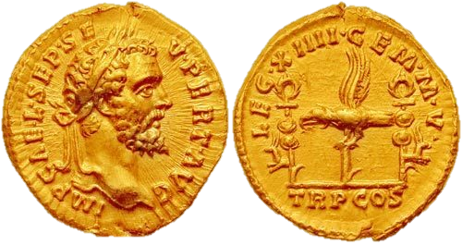
Artifact
The 3d artifact we made was a Aureus coin, which was the Romans' currency. It is important because it’s role and purpose is similar to today’s money role, we use it to buy, make trades…

Slide 5
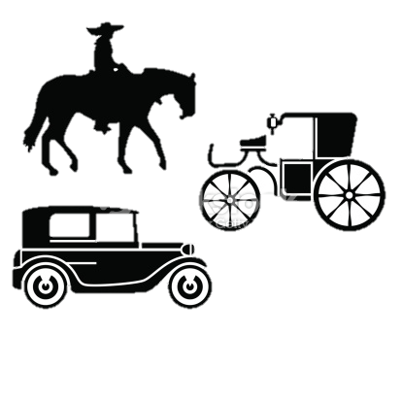
Economic System
Jobs: Ancient Rome was an agrarian and slave based economy whose main concern was feeding its vast number of citizens, so naturally their popular jobs are farmers and agriculture relating jobs. They are also famous for their powerful military force (soldiers), Gladiators, Traders, teachers and artists.
Technology: It was one of the most technologically advanced civilizations, with some of the more advanced concepts and inventions that were forgotten but then gradually be rediscovered. They are most advanced in engineering and architecture which is greatly influenced by the Greeks.
Money: Aureus, basic gold monetary unit of the Roman World.
Transportation: They travel on land and sea and by horses, carrige, boats, ships.
Trade: Trade was very vital to Ancient Romans and was greatly encouraged. They imported beef, corn, glassware, iron, marble, olive oil, perfumes, purple dye, silk, silver, spices, timber... The main trading partners were in Spain, France, the Middle East and North Africa.

Slide 6
Belief System
Religious beliefs and practices: In the early days, they were greatly influenced by the Greek gods and created their own similar set (Jupiter, Juno). They later on adapted Judaism and Christianity.

Slide 7
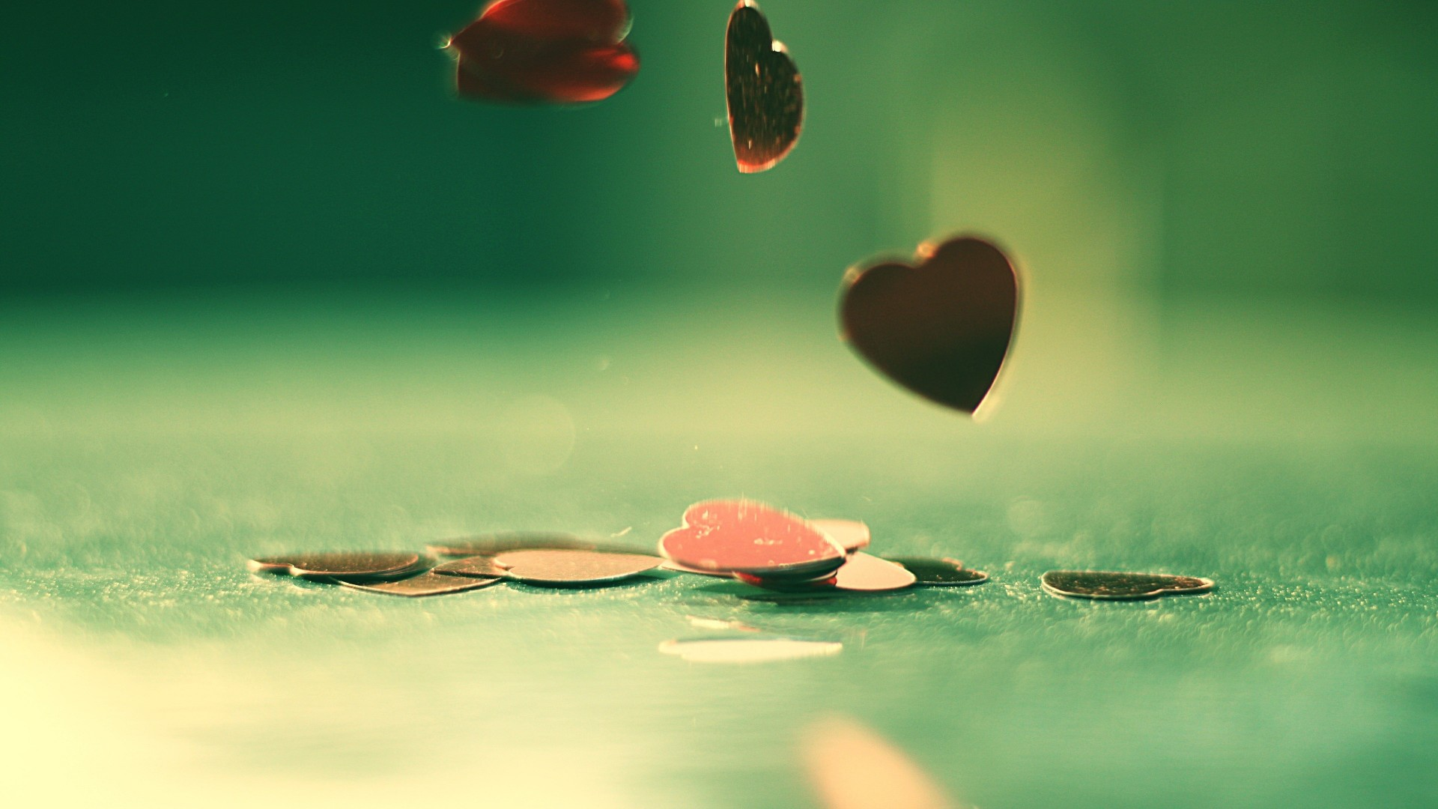
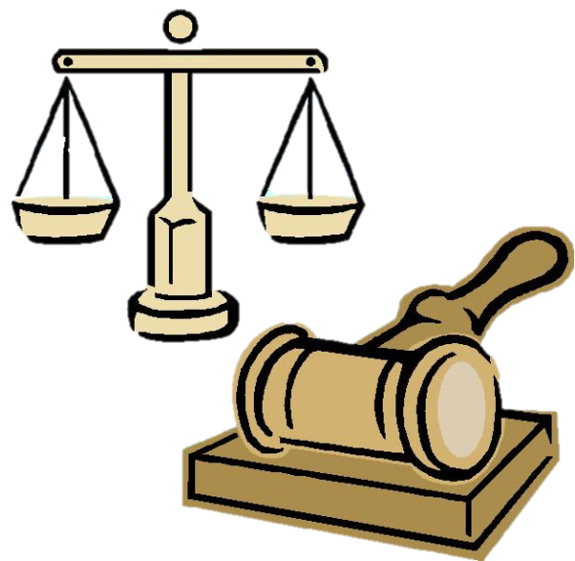
Political System
Type of government: The romans established a form of government still used today- the republic, a government in which citizens elected representatives to rule on their behalf. A republic is quite different from a democracy, in which every citizen is expected to play an active role in governing the state.
Who ruled and how rulers are chosen: The highest positions in the government were held by two consuls, or leaders, who ruled the Roman Republic. A senate composed of patricians (wealthy people) elected these consuls.

Slide 8
Social System
Roles of men, women and children:
Most women looked after the home, the children, complete chores, do handicrafts and join the family’s workforce.
Men were the masters of families. They would work outside of home.
Children were educated to the best of a family's ability. They were taught never to talk back to elders and to their family and they had to obey elders
How was families like in Ancient Rome?
The families in Rome included more than just the basic family of father, mother, and children. It also included all the people who were part of the household such as the slaves, servants, clients, and freedmen. As a result, some families in Rome grew quite large.

Slide 9
Art and Leisure
Holidays and festivals:
To honor their gods the romans gave festivals. There were so many gods it seemed like there was a festival almost every night.
Art style:
Roman art includes architecture, painting, sculpture and mosaic work. Luxury objects in metal-work, gem engraving, ivory carvings, and glass are sometimes considered in modern terms to be minor forms of Roman art
Leisure activities:
A lot of Romans enjoyed swimming, horseback riding, wrestling and boxing, running, hunting and fishing, ball games and board games
Some main authors in Ancient Rome are Catullus, Vergil, Horace, Ovid etc.

Slide 10
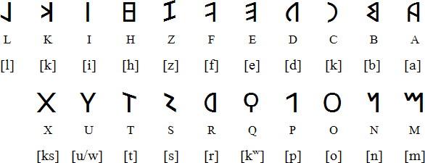
Writing System
The roman writing system is named the Language Latin.
What the writing looks like:

Slide 11
Works Cited
http://www.ushistory.org/civ/6a.asp
https://en.wikipedia.org/wiki/Ancient_Rome
http://www.ancient.eu/article/98/

Slide 12
Quiz

